Slide 1
Chemistry – Jan 7, 2020
P3 Challenge-
Determine the number of a) protons, b) neutrons and c) electrons present in an atom of Copper – 65. Then state the d) atomic number and the e) mass number.
Objective –
Bohr Model Review
Atomic Structure/QM Exploration Activity

Slide 2
Chemistry – Jan 7, 2020
Objective –
Atomic Structure / Quantum Mechanics
Agenda
Bohr model review with worksheet
QM overview and video
Orbital Shapes
Organization of orbitals via Activity
Assignment: Atomic Structure Activity

Slide 3
Valence Electrons / Core Electrons
Valence electrons located in the shell with the highest energy level. All other electrons are core electrons.
#Valence electrons varies from 1 to 8 with a completed octet most stable
Ex: Mg Highest Energy = 3 2 valence electrons
Ex: C Highest Energy = 2 4 valence electrons
Number of valence electrons will always match the group A number.
Atoms with the same number of valence electrons, that is, elements in the same A group, will have similar reactivity.

Slide 4
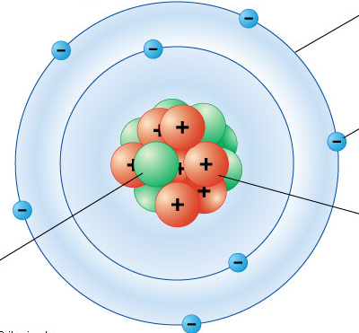
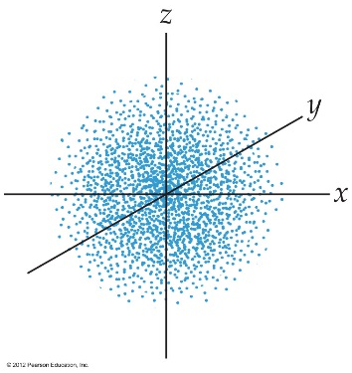
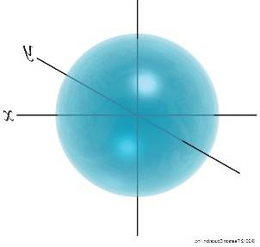
Review Atomic models
Recall the Nuclear model and where subatomic particles are located
Recall the Bohr model that uses quantized orbits
Recall Quantum Mechanics that uses quantized orbitals
Orbitals that we draw represent a 95% probability of finding an electron in that space.
Any single orbital can contain up to two electrons (0, 1, or 2)

Slide 5
Quantum Mechanics
Same as Bohr model except for how the energy levels are described.
Electrons located in orbitals.
Mathematical description is a “wave function” – Schrödinger
Explains the wave property of matter.
Strategy to understand QM:
Learn what the orbitals look like and how they’re organized on H atom with activity (today)
Populate the orbitals with electrons to describe other atoms using the periodic table (next time)

Slide 6
Shapes of Orbitals
Using different shapes is one way QM creates its quantized energy levels.
The more complicated the shape, the higher the energy level.
Four different basic orbital shapes: s p d f
Basic shapes double the number of lobes for each level:

Slide 7
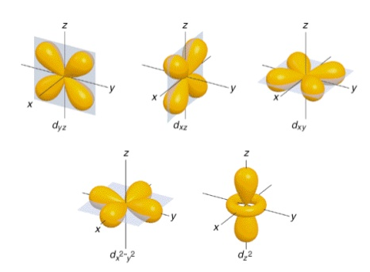
S, P, D, and F Orbitals

Slide 8
Overview Video
Orbitals, the Basics: Atomic Orbital Tutorial — probability, shapes, energy; Crash Chemistry Academy
https://www.youtube.com/watch?v=Ewf7RlVNBSA

Slide 9
Atomic Structure Exploration Activity
Obtain a copy of the subshell sheets and an envelope, one set per lab table, a box of colored pencils and a pair of scissors.
Complete an activity sheet for each team member.
Due by end of period
Submit an envelop of your atomic structure pieces labeled with all team member names
Work in groups of 3-4 on the Atomic Structure Exploration Activity.

Slide 11
Exit Slip - Homework
Exit Slip:
What’s Due? (Pending assignments to complete.)
Atomic Structure Activity
What’s Next? (How to prepare for the next day)
Read Holt p84 - 88

